Slide 1
How we store a graph in Python
graph = {
'A': ['B'],
'B': ['A', 'C', 'D'],
'C': ['B'],
'D': ['B']
}
Types of Graphs
1. Undirected
A — B (both ways)
2. Directed
A → B (one way only)

Slide 2
What is a Tree?
A tree is a special graph:
No cycles
Connected
Looks like hierarchy

Slide 3
Topological Sort
Only for directed graphs
Used when there are dependencies
Rule
Pick nodes with no incoming edges.
A node can be taken only if no one is pointing to it
This is called in-degree = 0

Slide 4
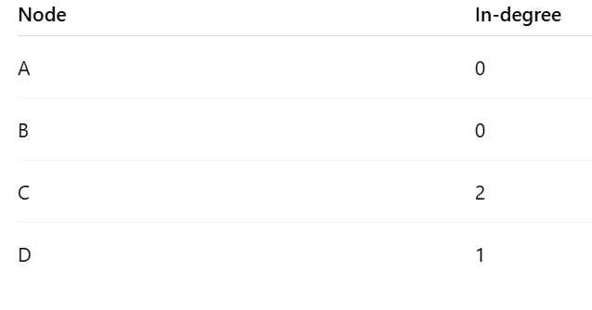
Kahn’s Algorithm
A → C
B → C
C → D
Step 1: Count in-degrees

Slide 5
Kahn’s Algorithm
Step 2: Take nodes with in-degree = 0
Take A, B
Output: A, B
Step 3: Remove their edges
C loses 2 incoming edges → becomes 0

Slide 6
Kahn’s Algorithm
Step 4: Take C
Output:A, B, C
Step 5: Remove C → D becomes 0
Take D:
Final: A, B, C, D
We are not rebuilding a new graph, we are just:
Removing processed nodes
Deleting their outgoing edges

Slide 7
Kahn’s Algorithm
from collections import deque
def topo_sort(graph):
indegree = {node: 0 for node in graph}
# Step 1: count indegrees
for node in graph:
for neighbor in graph[node]:
indegree[neighbor] += 1
# Step 2: queue nodes with 0 indegree
queue = deque([n for n in indegree if indegree[n] == 0])
result = []

Slide 8
Kahn’s Algorithm
#Driver Code:
graph = {
'A': ['C'],
'B': ['C'],
'C': ['D'],
'D': []
}
print(topo_sort(graph))
# Step 3: process
while queue:
node = queue.popleft()
result.append(node)
for neighbor in graph[node]:
indegree[neighbor] -= 1
if indegree[neighbor] == 0:
queue.append(neighbor)
return result
Output:
['A', 'B', 'C', 'D']

Slide 9
Applications
(a) Course Planning
You must complete Data Structures before Algorithms
You must complete Math before Machine Learning
Topological sort gives a valid study order
(b) Package Installation
Install library A before B
Install B before C

